Slide 1

Hello,
Presenting-
Md. Ferdaus Hossen
ID: 221002171
Dept. of CSE
Green University Of Bangladesh

Slide 2
Topic & Outline
Topic: Lab Project
Project Name: Information Management System (Students Record)
Outlines-
Introduction to application
Technology
Features
Advantages & disadvantages
Conclusion

Slide 3
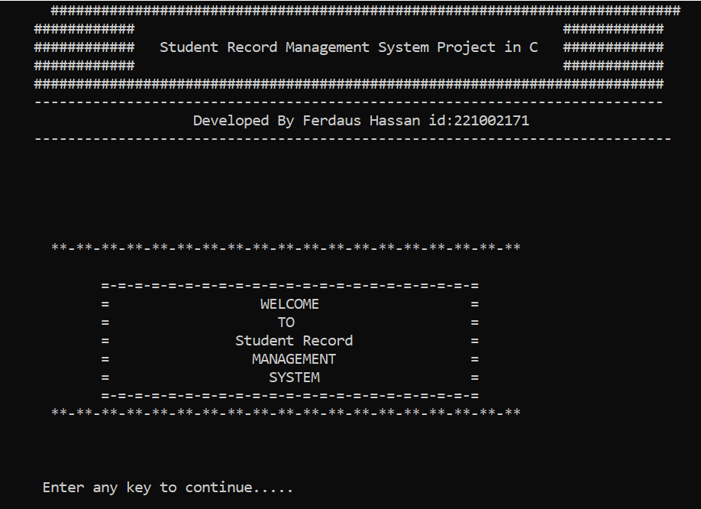
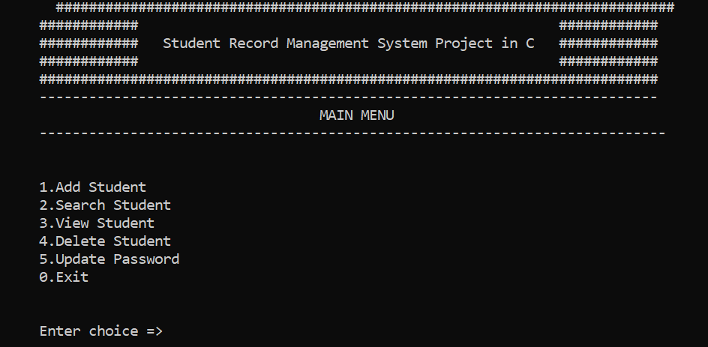
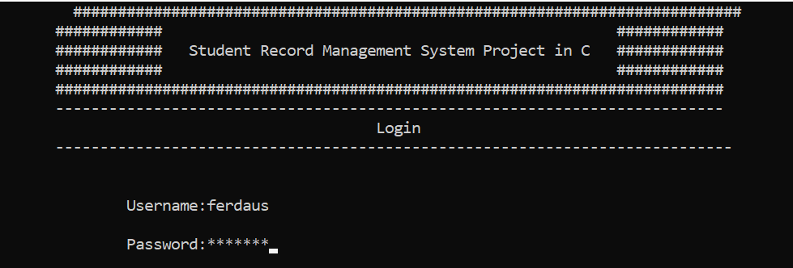
Introduction:

Slide 4
Technology I use
I use C Programming Language to create this project . It’s a console application . Here I use some pre-build functions and methods to complete the functionality of this console application. Long lasting memory allocation also used here so that user can find out all of data saved before the application exit.

Slide 5

Features
An user can store a full details of any membership organization.
Add member with full details .
Search by id number and name
Delete information of any member
And strong memory allocation to save the information input by user.

Slide 6
Advantages & Disadvantages
Disadvantages
Advantages
It’s a console base application
Weak Security system
Open code area
Need a compiler to run
Easy to use
Developer friendly
Easy input system
Small size

Slide 7
Conclusion
In the period of time when I was working with this project I face a lot of barrier and problems to solve the mistakes happening continuously by me .
But from the making of this project my skill developed so much and I understand a lot of usage of c programming language.

Slide 8
References
[1] Cppbuzz.com Website: https://www.cppbuzz.com/projects/c/student-record_x0002_management-in-c
[2] Anisul Islam . Youtube: Anisul Islam.

Slide 9
Thank you

